Slide 1

Achieving Competitive Advantage with Information Systems
Chapter 3
Ali Bazarah
MIS 300

Slide 2
Learning Objectives
3.1 How do Porter’s competitive forces model, the value chain model, synergies, core competencies, and network-based strategies help companies use information systems for competitive advantage?
3.2 How do information systems help businesses compete globally?
3.3 How do information systems help businesses compete using quality and design?
3.4 What is the role of business process management (B P M) in enhancing competitiveness?

Slide 3
Porter’s Competitive Forces Model
Porter’s model is all about the firm’s general business environment
Five competitive forces shape fate of firm
Traditional competitors
New market entrants
Substitute products and services
Customers
Suppliers

Slide 4
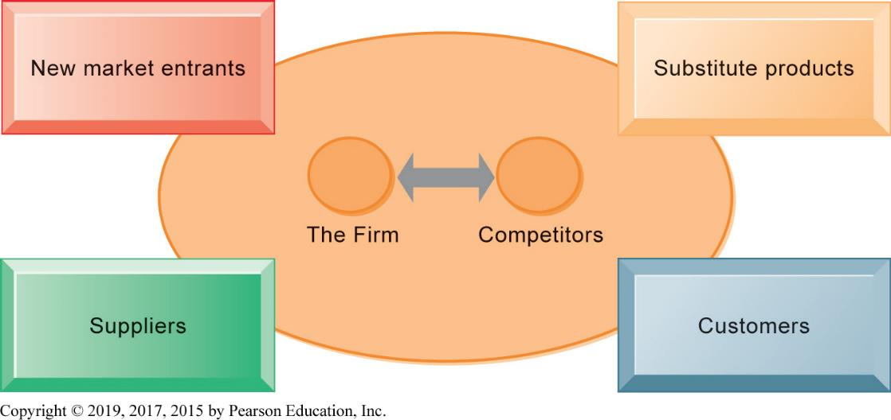
Figure 3.1 Porter’s Competitive Forces Model

Slide 5
Information System Strategies for Dealing with Competitive Forces (1 of 5)
Basic strategy: Align I T with business objectives
Identify business goals and strategies
Break strategic goals into concrete activities and processes
Identify metrics for measuring progress
Determine how I T can help achieve business goals
Measure actual performance

Slide 6
Information System Strategies for Dealing with Competitive Forces (2 of 5)
Low-cost leadership
Use information systems to achieve the lowest operational costs and the lowest prices
E.g. Walmart
Inventory replenishment system sends orders to suppliers when purchase recorded at cash register
Minimizes inventory at warehouses, operating costs
Efficient customer response system

Slide 7
Information System Strategies for Dealing with Competitive Forces (3 of 5)
Product differentiation
Use information systems to enable new products and services, or greatly change the customer convenience in using your existing products and services
E.g., Google's continuous innovations, Apple's i Phone
Use information systems to customize, personalize products to fit specifications of individual consumers

Slide 8
Information System Strategies for Dealing with Competitive Forces (4 of 5)
Focus on market niche
Use information systems to enable specific market focus, and serve narrow target market better than competitors.
Analyzes customer buying habits, preferences
Advertising pitches to smaller and smaller target markets
E.g., Hilton Hotel’s On Q System
Analyzes data collected on guests to determine preferences and guest's profitability

Slide 9
Information System Strategies for Dealing with Competitive Forces (5 of 5)
Strengthen customer and supplier intimacy.
Strong linkages to customers and suppliers increase switching costs and loyalty
Toyota: uses I S to facilitate direct access from suppliers to production schedules
Permits suppliers to decide how and when to ship supplies to plants, allowing more lead time in producing goods.
Amazon: keeps track of user preferences for purchases, and recommends titles purchased by others

Slide 10
The Internet’s Impact on Competitive Advantage
Enables new products and services
Encourages substitute products
Lowers barrier to entry
Changes balance of power of customers and suppliers
Transforms some industries
Creates new opportunities for creating new markets, building brands, and large customer bases
Smart products and the Internet of Things

Slide 11
The Business Value Chain Model
Highlights specific activities in a business where competitive strategies can best be applied and where information systems are likely to have a strategic impact.
The goal is to be more efficient.
Primary activities
directly related to production and distribution
Support activities
Benchmarking
Best practices

Slide 12
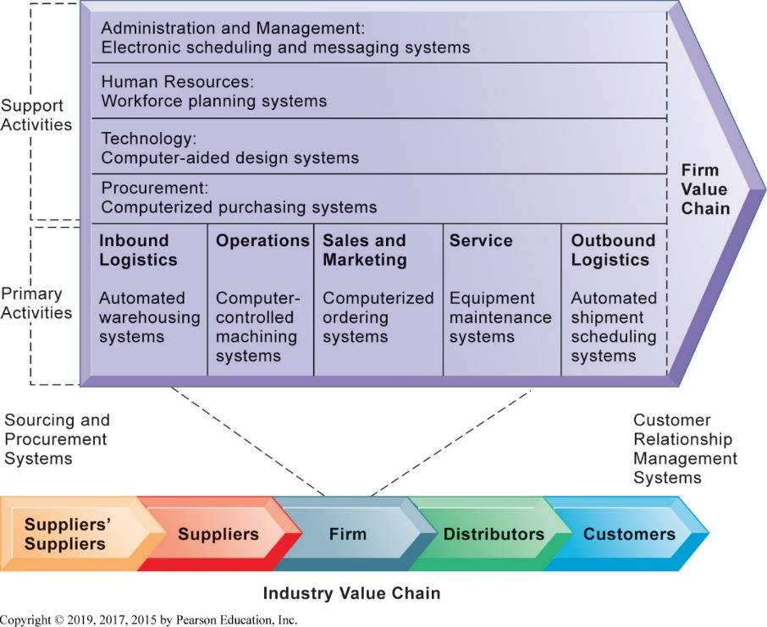
Figure 3.2 The Value Chain Model

Slide 13
The Value Web
A firm’s value chain is linked to the value chains of its suppliers, distributors, and customers.
Value web
Collection of independent firms that use information technology to coordinate their value chains to produce a product collectively.
Value webs are flexible and adapt to changes in supply and demand.

Slide 14
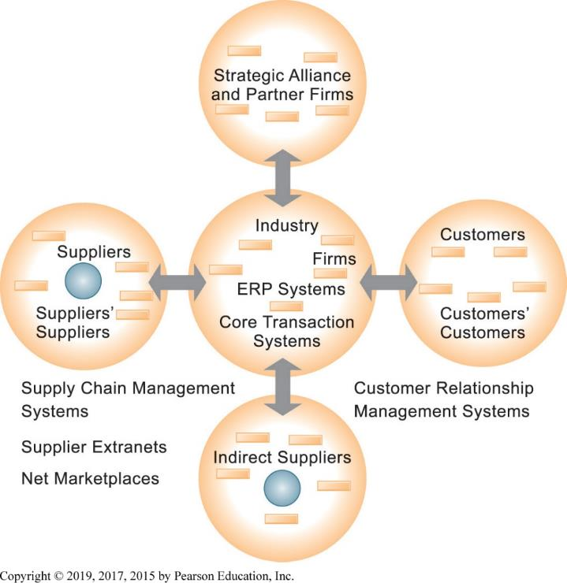
Figure 3.3 The Value Web
Notes:
Figure 3.3, Page 91.
The value web is a networked system that can synchronize the value chains of business partners within an industry to respond rapidly to changes in supply and demand.

Slide 15
Synergies
When output of some units can be used as inputs to other units
When two firms can pool markets and expertise (e.g., recent bank mergers)
Lower costs and generate profits
Enabled by information systems that ties together disparate units so they act as whole.
E.g.: eBay and PayPal

Slide 16
Core Competency
Activities for which firm is world-class leader
E.g., best package delivery service, etc
Relies on knowledge gained over years of experience as well as knowledge research
Any information system that encourages the sharing of knowledge across business units enhances competency

Slide 17
Network-Based Strategies
Focus usually on Internet opportunities and companies
Marginal costs of adding another participant are near zero, whereas marginal gain is much larger
E.g., larger number of participants in Internet, greater value to all participants
Virtual company
Uses networks to link people, resources, and ally with other companies to create and distribute products without traditional organizational boundaries or physical locations

Slide 18
Disruptive Technologies
Technologies with disruptive impact on industries and businesses, rendering existing products, services and business models obsolete
Personal computers
World Wide Web
Internet music services

Slide 19
The Internet and Globalization
Prior to the Internet, competing globally was only an option for huge firms able to afford factories, warehouses, and distribution centres abroad.
The Internet drastically reduces costs of operating globally.
Globalization benefits
Scale economies and resource cost reduction
Higher utilization rates, fixed capital costs, and lower cost per unit of production
Speeding time to market

Slide 20
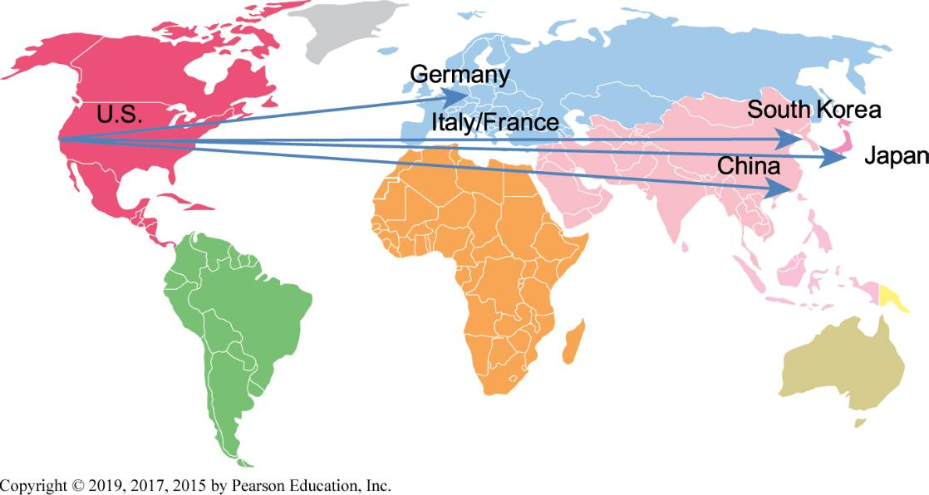
Figure 3.4 Apple i Phone’s Global Supply Chain
Notes:
Figure 3.4, Page 94.
Apple designs the iPhone in the United States and relies on suppliers in the United States, Germany, Italy, France, and South Korea for parts. Final assembly occurs in China.

Slide 21
Global Business and System Strategies
Domestic exporters: company exports products to foreign companies
Multinationals: Part of the company is located in the domestic country and other parts are located in foreign countries.
Franchisers:create, design, and finance the product in the home country, but rely on foreign operations for further production, marketing, and human resources.
Transnational: It has no single national headquarters, but instead has many regional headquarters

Slide 22
Global System Configuration
Centralized systems
systems development and operations occur totally at the domestic home base.
Duplicated systems
systems development occurs totally at the home base, but operations are handed in foreign locations.
Decentralized systems
each foreign unit designs its own, totally unique solutions and systems.
Networked systems
systems development and operations occur in an integrated and coordinated fashion across all units

Slide 23
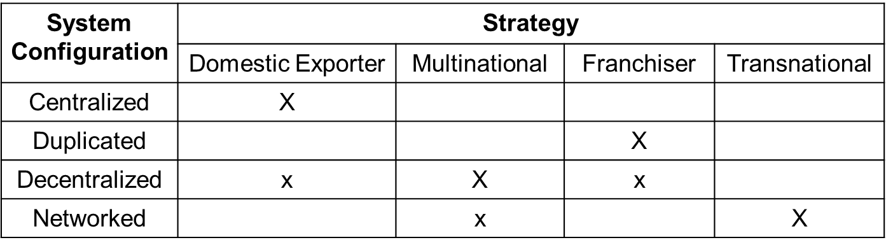
Figure 3.5 Global Business Organization Systems Configurations
Notes:
Figure 3.5, Page 96.
The large Xs show the dominant patterns, and the small Xs show the emerging patterns. For instance, domestic exporters rely predominantly on centralized systems, but there is continual pressure and some development of decentralized systems in local marketing regions.

Slide 24
What is Quality?
Producer perspective
Conformance to specifications and absence of variation from specs
Customer perspective
Physical quality (reliability), quality of service, psychological quality
Total quality management (T Q M )
Quality control is end in itself
All people, functions responsible for quality
Six sigma
Measure of quality: 3.4 defects/million opportunities

Slide 25
How Information Systems Improve Quality
Reduce cycle time and simplify production
Shorter cycle times mean that problems are caught earlier in the process
Benchmark: Determine how the company stand up against its competitors
Use customer demands to improve products and services
Improve design quality and precision
Computer-aided design (C A D) systems

Slide 26
What is Business Process Management (B P M )?
Technology alone is often not enough to improve business
Organizational changes often necessary
Minor changes in work habits
Redesigning entire business processes
Aims to continuously improve processes
Uses variety of tools and methodologies to
Understand existing processes
Design and optimize new processes

Slide 27
Steps in B P M
Identify processes for change
Analyze existing processes
Design new process
Implement new process
Continuous measurement

Slide 28
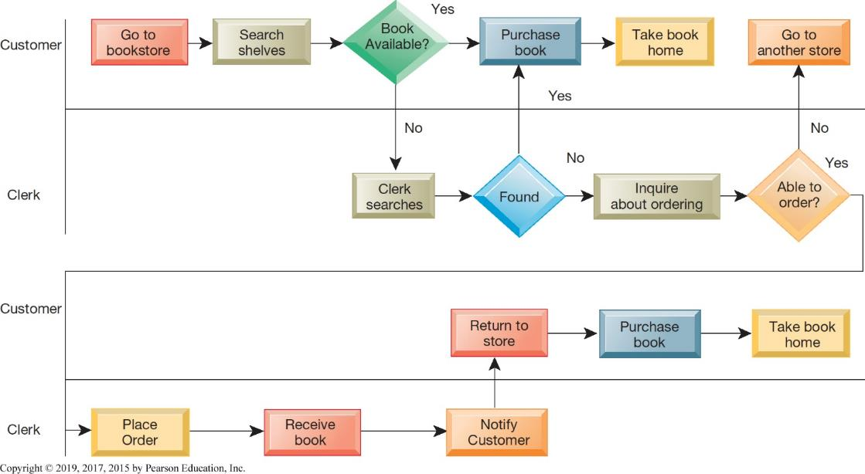
Figure 3.6 As-Is Business Process for Purchasing a Book from a Physical Bookstore
Notes:
Figure 3.6, Page 100.
Purchasing a book from a physical bookstore requires both the seller and the customer to perform many steps.

Slide 29
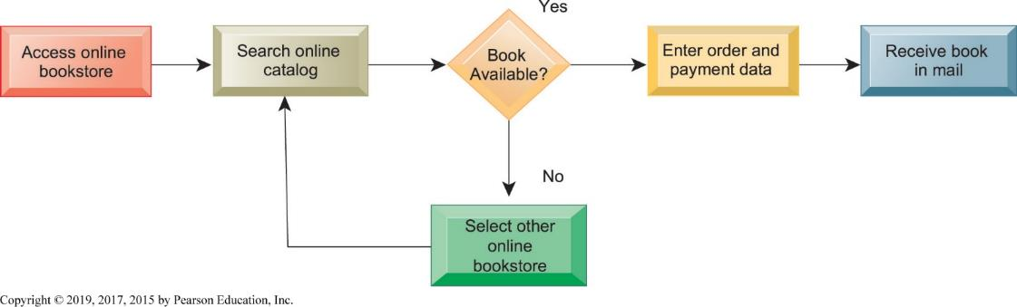
Figure 3.7 Redesigned Process for Purchasing a Book Online
Notes:
Figure 3.7, Page 101.
Using Internet technology makes it possible to redesign the process for purchasing a book so that it only has a few steps and consumes
fewer resources.
Competing on business processes almost always means simplifying the process, reducing the number of people involved, reducing the decision time, expanding the remaining employees' job responsibilities, and using information systems to speed the flow and quality of information.

Slide 30
Business Process Reengineering
A radical form of fast change
Not continuous improvement, but elimination of old processes, replacement with new processes, in a brief time period
Can produce dramatic gains in productivity
Can produce more organizational resistance to change

